Slide 1
MODULE2
Connecting Smart Objects

Slide 2
Connecting Smart Objects
IoT devices and sensors must be connected to the network for their data to be utilized.
In addition to the wide range of sensors, actuators, and smart objects that make up IoT
there are also a number of different protocols used to connect them.
Two main sections divide this first main section, “Communications Criteria,” describes the characteristics and attributes you should consider when selecting and dealing with connecting smart objects.

Slide 3
The various technologies used for connecting sensors can differ greatly depending on the criteria used to analyze
them
Range: describes the importance of signal propagation and distance
Frequency Bands: describes the licensed and unlicensed spectrum, including sub-GHz frequencies
Power Consumption: describes the the considerations required for devices connected to a stable power source compared to those that are battery powered
Topology: describes the various layouts that may be supported for connecting Multiple smart objects
Constrained Devices: describes the limitations of certain smart objects from a Connectivity perspective
Constrained-Node Networks: describes the challenges that are often encountered with networks connecting smart objects

Slide 4
The second main section
“IoT Access
Technologies,” provides an in-depth look at some ofthe technologies that are considered when connecting smart objects
Currently the number of technologies connecting smart objects is quite extensive, but you should expect consolidation, with certain protocols eventually winning out over others in the various IoT market segments
This section intentionally limits the discussion of technologies for connecting sensors to the ones that seem to be most promising going forward in the IoT marketplace

Slide 5
The following subsections cover technologies for connecting smart objects:
IEEE 802.15.4: highlights IEEE 802.15.4, an older but foundational wireless Protocol for connecting smart objects.
IEEE 802.15.4g and IEEE 802.15.4e: discusses improvements to
802.15.4 that are targeted to utilities and smart cities deployments.
IEEE 1901.2a: discusses IEEE 1901.2a, which is a technology for connecting smart objects over power lines.
IEEE 802.11ah: discusses IEEE 802.11ah, a technology built on the well-known 802.11 Wi-Fi standards that is specifically for smart objects.
NB-IoT and Other LTE Variations: discusses NB-IoT and other LTE variations, which are often the choice of mobile service providers looking to connect smart objects over longer distances in the licensed spectrum.

Slide 6
The various technologies used for connecting sensors can differ greatly depending on the criteria used to analyze them
Range:How far does the signal need to be propagated?
That is, what will be the area of coverage for a selected wireless technology?
Should indoor versus outdoor deployments be differentiated?
Very often, these are the first questions asked when discussing wired and wireless access technologies.
The simplest approach to answering these types of questions is to categorize these technologies as shown in Figure 4-1, breaking them down into the following ranges

Slide 7
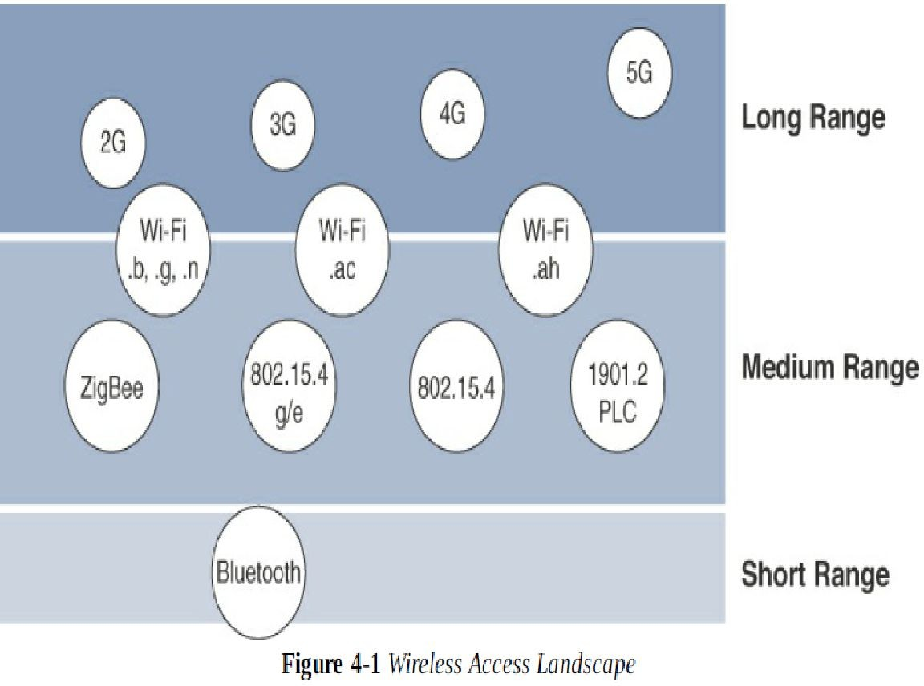

Slide 8
Frequency Bands
Telecommunication Union (ITU) and the Federal Communications Commission (FCC). These groups define the regulations and transmission requirements for various frequency bands
For example, portions of the spectrum are allocated to types of telecommunications such as radio, television, military, and so on around the world
the spectrum for various communications uses is often viewed as a critical resource
For example, you can see the value of these frequencies by examining the cost that mobile operators pay for licenses in the cellular spectrum
Examples of licensed spectrum commonly used for IoT access are cellular, WiMAX, and Narrowband IoT (NB-IoT) technologies.

Slide 9
The ITU has also defined unlicensed spectrum for the industrial, scientific, and medical (ISM) portions of the radio bands.
These frequencies are used in many communications technologies for short-range devices (SRDs).
Unlicensed means that no guarantees or protections are offered in the ISM bands for device communications. For IoT access, these are the most well-known ISM bands
2.4 GHz band as used by IEEE 802.11b/g/n Wi-Fi
IEEE 802.15.1 Bluetooth
IEEE 802.15.4 WPAN
Unlicensed spectrum is usually simpler to deploy than licensed because it does not require a service provider

Slide 10
Focusing on IoT access technologies, the frequency bands leveraged by wireless communications are split between licensed and unlicensed bands.
Licensed spectrum is generally applicable to IoT long-range access technologies and allocated to communications infrastructures deployed by services providers, public services
for example, first responders, and military, broadcasters, and utilities.
An important consideration for IoT access infrastructures that wish to utilize licensed spectrum is that users must subscribe to services when connecting their IoT devices

Slide 11
Power Consumption
While the definition of IoT device is very broad, there is a clear delineation between powered nodes and battery-powered nodes.
A powered node has a direct connection to a power source, and communications are usually not limited by power consumption criteria
Battery-powered nodes bring much more flexibility to IoT devices.
Does a node need 10 to 15 years of battery life, such as on water or gas meters? Or is a 5- to 7-year battery life sufficient for devices
such as smart parking sensors This has led to the evolution of a new wireless environment known as Low-Power Wide-Area (LPWA).

Slide 12
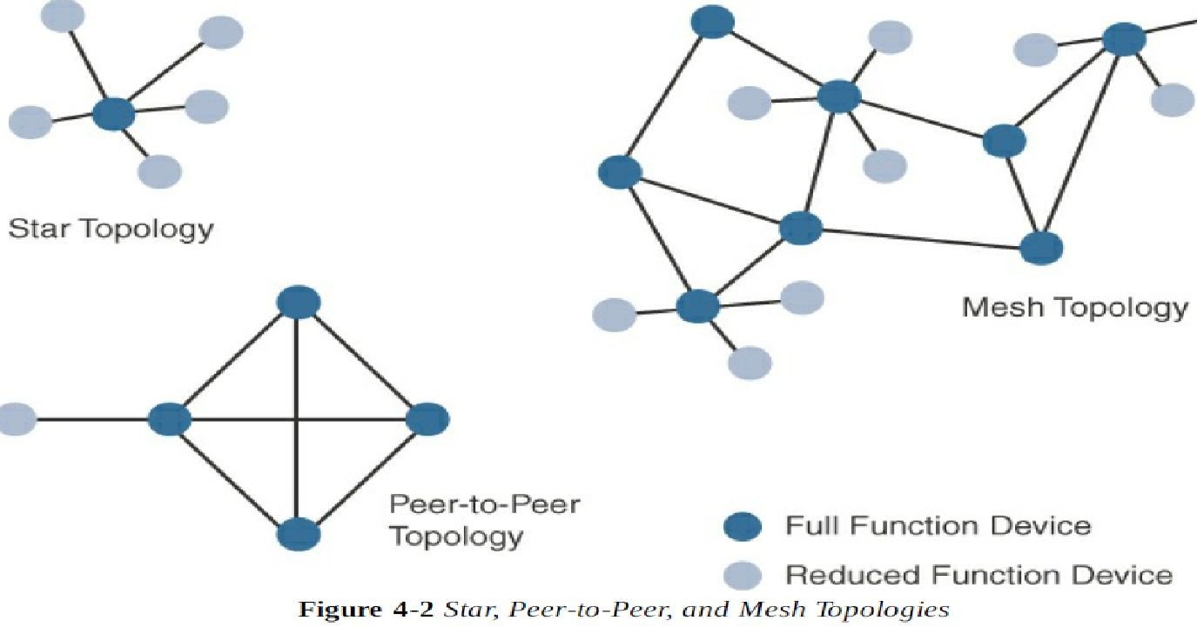
Topology
Among the access technologies available for connecting IoT devices, three main topology schemes are dominant: star, mesh, and peer-to-peer. For long-range and short-range technologies

Slide 13
Constrained Devices
Differentiate constrained nodes from unconstrained nodes, such as servers, desktop or laptop computers, and powerful mobile devices such as smart phones
Constrained nodes have limited resources that impact their networking feature set and capabilities
Therefore, some classes of IoT nodes do not implement an IP stack. According to RFC 7228, constrained nodes can be broken down into the classes class0 ,class1 and class2

Slide 14
Constrained-Node Networks
While several of the IoT access technologies, such as Wi-Fi and cellular, are applicable to laptops, smart phones, and some IoT devices,
some IoT access technologies are more suited to specifically connect constrained nodes.
Typical examples are IEEE 802.15.4 and 802.15.4g RF, IEEE 1901.2a PLC, LPWA, and IEEE 802.11ah
access technologies.
Constrained-node networks are often referred to as low-power and lossy networks (LLNs). (Low-power in the context of LLNs refers to the fact that nodes must cope with the requirements from powered and battery-powered constrained nodes

Slide 15
Layer 1 and Layer 2 protocols that can be used for constrained-node networks must be evaluated in the context of the following characteristics for use-case applicability: data rate and throughput, latency and Determinism, and overhead and payload
Data Rate and Throughput
The data rates available from IoT access technologies range from 100 bps with protocols such as Sigfox to tens of megabits per second
with technologies such as LTE and IEEE 802.11ac. However, the actual throughput is

Slide 16
Latency and Determinism
Much like throughput requirements, latency expectations of IoT applications should be known when selecting an access technology
This is particularly true for wireless networks, where packet loss and retransmissions due to interference, collisions, and noise are normal behaviours.
On constrained networks, latency may range from a few milliseconds to seconds, and applications and protocol stacks must cope with these wide-ranging value

Slide 17
Overhead and Payload
When considering constrained access network technologies, it is important to review the MAC payload size characteristics required by applications.
In addition, you should be aware of any requirements for IP.
The minimum IPv6 MTU size is expected to be 1280 bytes.
Therefore, the fragmentation of the IPv6 payload has to be taken into account by link layer access protocols with smaller MTUs.
For technologies that fall under the LLN definition but are able to transport IP, such as IEEE 802.15.4 and 802.15.4g, IEEE 1901.2, and IEEE 802.11ah, Layer 1
or Layer 2 fragmentation capabilities and/or IP optimization is important.

Slide 18
IoT Access Technologies
A common information set is addressed for the following topics for each IoT access technology
Standardization and alliances: The standards bodies that maintain the protocols for a technology
Physical layer: The wired or wireless methods and relevant frequencies
MAC layer: Considerations at the Media Access Control (MAC) layer, which bridges the physical layer with data link control
Topology: The topologies supported by the technology
Security: Security aspects of the technology
Competitive technologies: Other technologies that are similar and may be suitable alternatives to the given technology

Slide 19
IEEE 802.15.4
IEEE 802.15.4 is a wireless access technology for
low-cost and low-data-rate devices that are powered or run on batteries
This access technology enables easy installation using a compact protocol stack while remaining both simple and flexible.
IEEE 802.15.4 is commonly found in the following types of deployments:
Home and building automation
Automotive networks
Industrial wireless sensor networks
Interactive toys and remote controls
Criticisms of IEEE 802.15.4 often focus on its MAC reliability, unbounded latency, and susceptibility to interference and multipath fading.

Slide 20
Standardization and Alliances
IEEE 802.15.4 or IEEE 802.15 Task Group 4 defines low-data-rate PHY and MAC layer specifications for wireless personal area networks (WPAN).
This standard has evolved over the years and is a well-known solution for low-complexity wireless devices with low data rates that need many months or even years of battery life
there is no alliance or promotion body for IEEE 802.15.4 the IEEE 802.15.4 PHY and MAC layers are the foundations for several networking protocol stacks.
These protocol stacks make use of 802.15.4 at the physical and link layer levels, but the upper layers are different
Some of the most well-known protocol stacks based on
802.15.4 are highlighted in Table 4-2

Slide 21
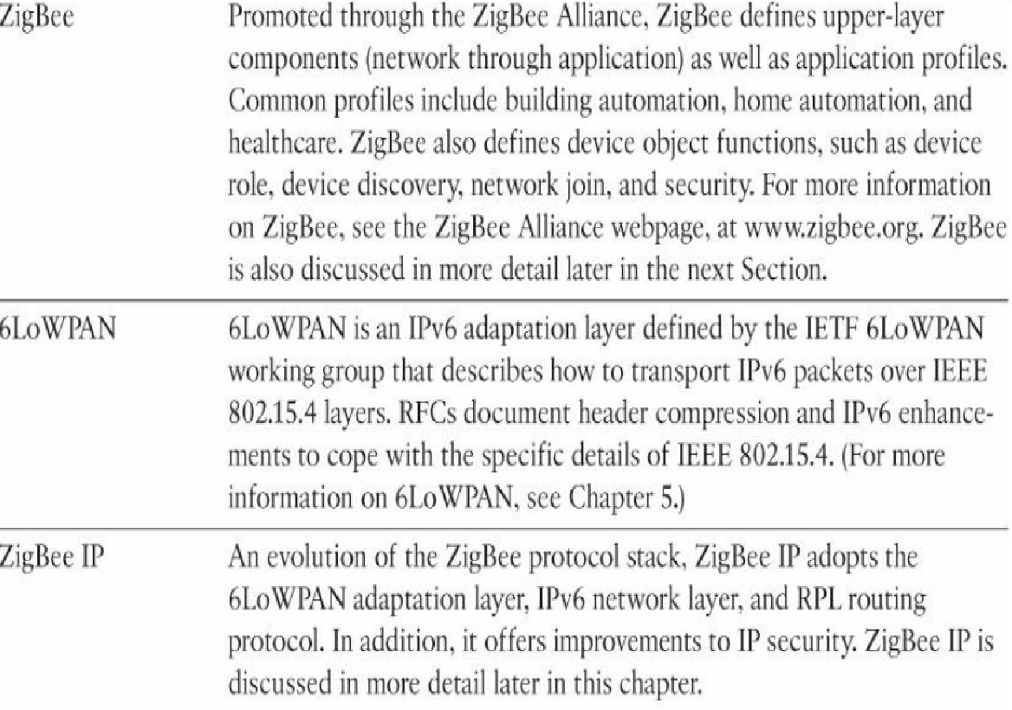

Slide 22
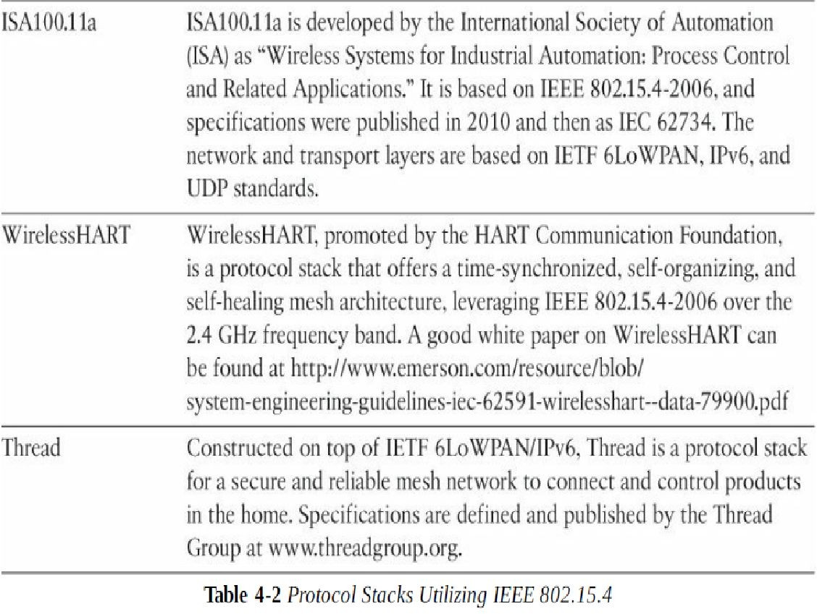

Slide 23
ZigBee
ZigBee solutions are aimed at smart objects and sensors that have low bandwidth and low power needs
Furthermore, products that are ZigBee compliant and certified by the ZigBee Alliance should interoperate even though different vendors may manufacture them
to achieve different functions for a device, such as metering, temperature, or lighting control
The main areas where ZigBee is the most well-known include automation for commercial, retail, and home applications and smart energy. In the industrial and commercial automation space

Slide 24
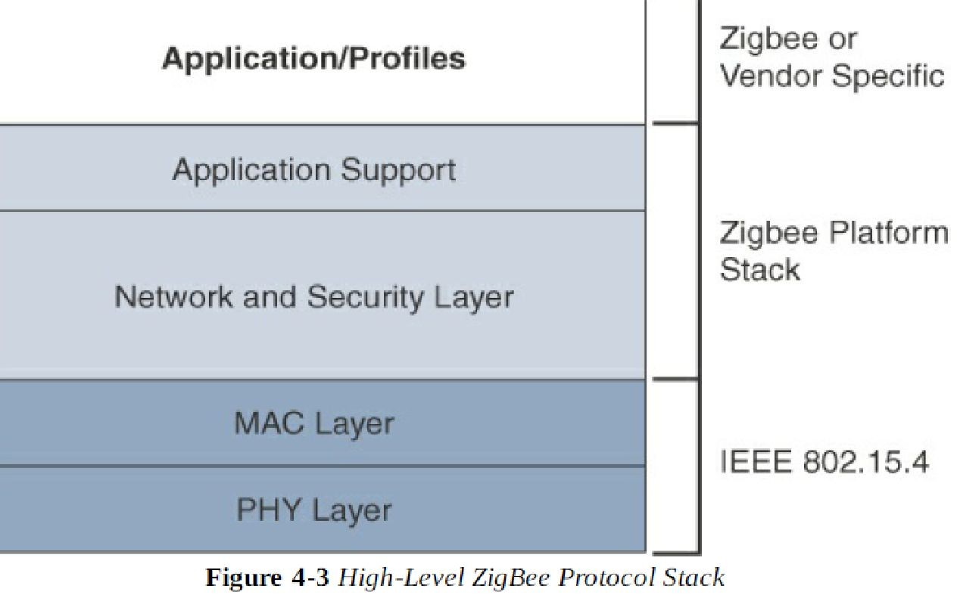
The traditional ZigBee stack is illustrated in Figure 4-3. As mentioned previously, ZigBee utilizes the IEEE 802.15.4 standard at the lower PHY and MAC layers

Slide 25
The ZigBee network and security layer provides mechanisms for network start-up, configuration, routing, and securing communications
The network layer is also responsible for forming the appropriate topology, which is often a mesh but could be a star or tree as well
From a security perspective, ZigBee utilizes 802.15.4 for security at the MAC layer, using the Advanced Encryption Standard (AES) with a 128-bit key and also provides security at the network and application layers
The application support layer in Figure 4-3 interfaces the lower portion of the stack dealing with the Networking of ZigBee devices with the higher-layer applications

Slide 26
ZigBee IP
With the introduction of ZigBee IP, the support of IEEE 802.15.4 continues, but the IP and TCP/UDP protocols and various other open standards are now supported at the network and transport layers
The ZigBee-specific layers are now found only at the top of the protocol stack for the applications
ZigBee IP was created to embrace the open standards coming from the IETF’s work on LLNs, such as IPv6, 6LoWPAN, and RPL
Any other applications that need a standards-based IoT stack can utilize Zigbee IP. The ZigBee IP stack is shown in Figure 4-4.

Slide 27
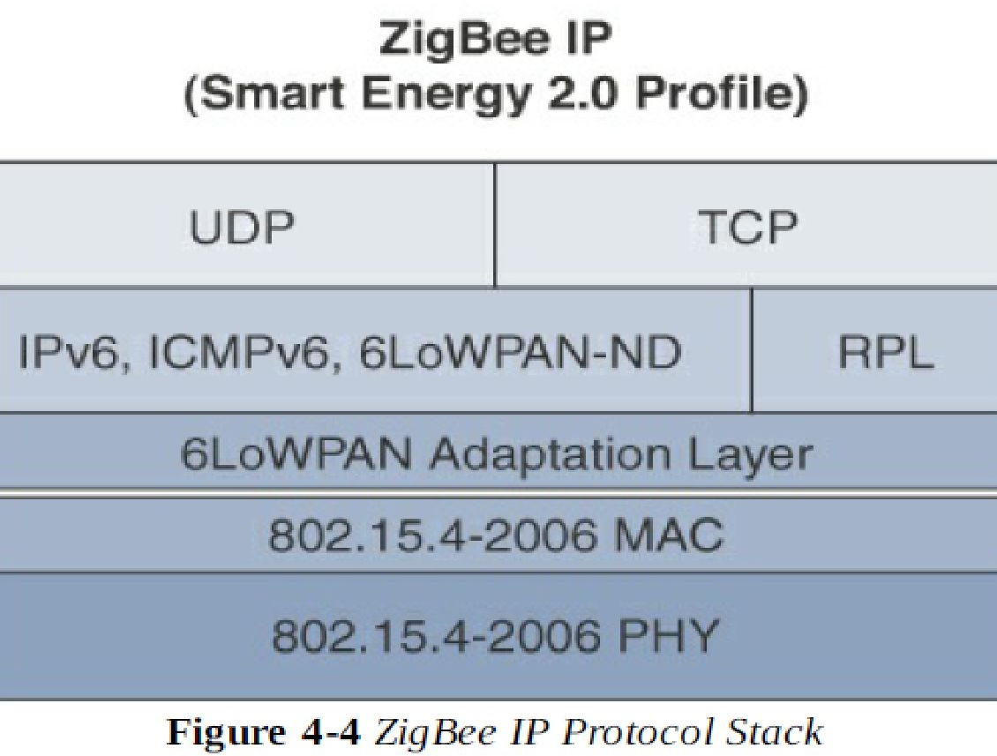

Slide 28
802.15.4 Physical Layer
The 802.15.4 standard supports an extensive number of PHY options that range from 2.4 GHz to sub-GHz frequencies in ISM bands.
The original IEEE 802.15.4-2003 standard specified only three PHY options based on direct sequence spread spectrum (DSSS) modulation
The original physical layer transmission options were as follows
2.4 GHz, 16 channels, with a data rate of 250 kbps
915 MHz, 10 channels, with a data rate of 40 kbps
868 MHz, 1 channel, with a data rate of 20 kbps

Slide 29
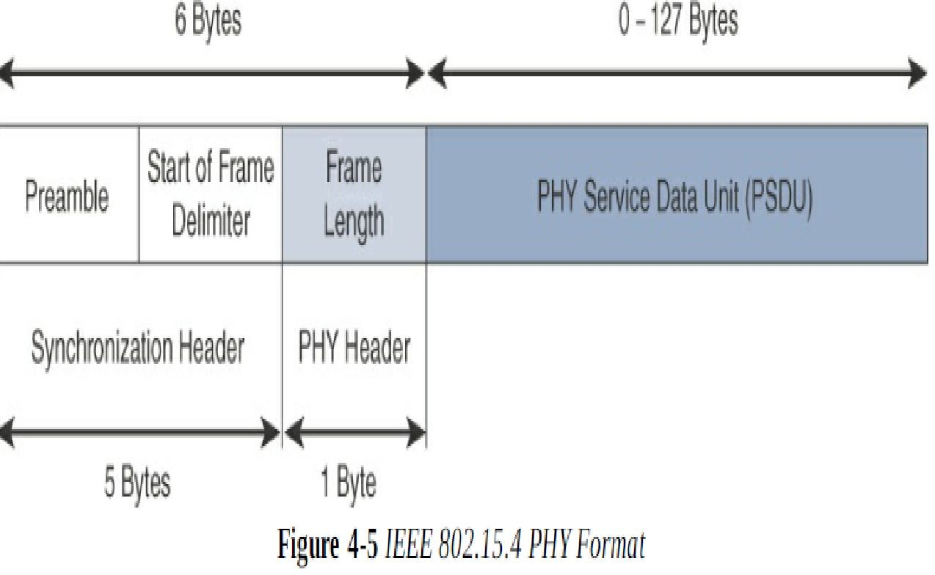
Figure 4-5 shows the frame for the 802.15.4 physical layer

Slide 30
The synchronization header for this frame is composed of the Preamble and the Start of Frame Delimiter fields
The Preamble field is a 32-bit 4-byte pattern that identifies the start of the frame and is used to synchronize the data transmission
The Start of Frame Delimiter field informs the receiver that frame contents start immediately after this byte.
The PHY Header portion of the PHY frame shown in Figure 4-5 is simply a frame length value
It lets the receiver know how much total data to expect in the PHY service data unit (PSDU) portion of the 802.4.15 PHY. The PSDU is the data field or payload

Slide 31
IEE 802.15.4 MAC Layer
The IEEE 802.15.4 MAC layer manages access to the PHY channel by defining how devices in the same area will share the frequencies allocated
At this layer, the scheduling and routing of data frames are also coordinated.
The 802.15.4 MAC layer performs the following tasks
Network beaconing for devices acting as coordinators (New devices use beacons to join an 802.15.4 network)PAN association and disassociation by a device security Reliable link communications between two peer MAC entities
The MAC layer achieves these tasks by using various predefined frame type

Slide 32
four types of MAC frames are specified in 802.15.4
Data frame: Handles all transfers of data
Beacon frame: Used in the transmission of beacons from a PAN coordinator
Acknowledgement frame: Confirms the successful reception of a frame
MAC command frame: Responsible for control communication between devices
Each of these four 802.15.4 MAC frame types follows the frame format shown in Figure 4-6. In Figure 4-6, notice that the MAC frame is carried as the PHY payload. The 802.15.4 MAC frame can be broken down into the MAC Header, MAC Payload, and MAC Footer fields

Slide 33
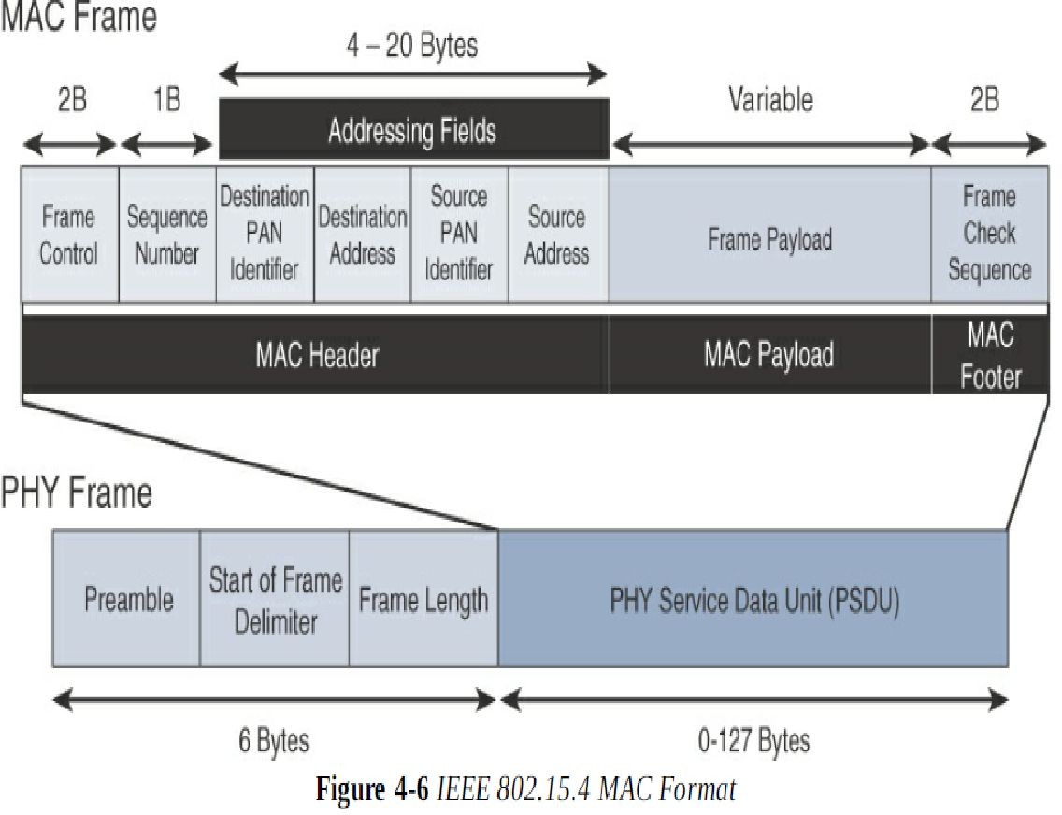

Slide 34
The MAC Header field is composed of the Frame Control, Sequence Number and the Addressing fields
The Frame Control field defines attributes such as frame type, addressing modes, and other control flags
The Sequence Number field indicates the sequence identifier for the frame.
The Addressing field specifies the Source and Destination PAN Identifier fields as well as the Source and Destination Address fields
The MAC Payload field varies by individual frame type
For example, beacon frames have specific fields and payloads related to beacons, while MAC command frames have different fields present

Slide 35
The MAC Footer field is nothing more than a frame check sequence (FCS).
An FCS is a calculation based on the data in the frame that is used by the receiving side to confirm the integrity of the data in the frame.
IEEE 802.15.4 requires all devices to support a unique 64-bit extended MAC address, based on EUI-64.
However, because the maximum payload is 127 bytes,
802.15.4 also defines how a 16-bit “short address” is assigned to devices
This short address is local to the PAN and substantially reduces the frame overhead compared to a 64-bit extended MAC address

Slide 36
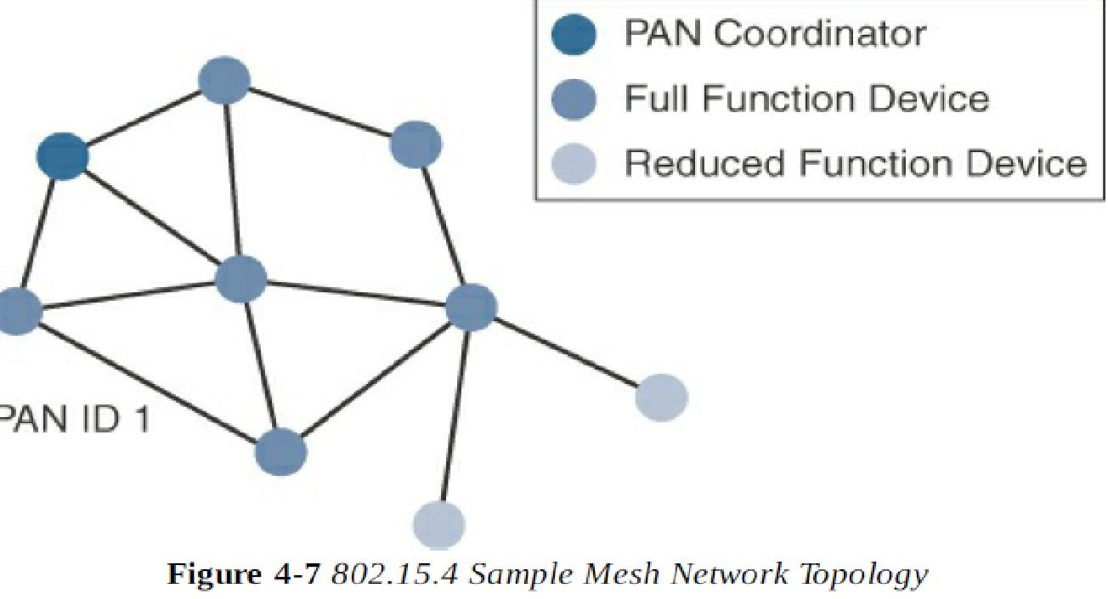
Topology
IEEE 802.15.4–based networks can be built as star, peer-to-peer, or mesh topologies. Mesh networks tie together many nodes. This allows nodes that would be out of range if trying to communicate directly to leverage intermediary nodes to transfer communications

Slide 37
Security
The IEEE 802.15.4 specification uses Advanced Encryption Standard (AES) with a 128-bit key length as the base encryption algorithm for securing its data.
AES is a block cipher, which means it operates on fixed-size blocks of data. (A symmetric key means that the same key is used for both the encryption and decryption of the data.)
Figure 4-8 shows the IEEE 802.15.4 frame format at a high level, with the Security Enabled bit set and the Auxiliary Security Header field present
Enabling these security features for 802.15.4 changes the frame format slightly and consumes some of the payload

Slide 38
Using the Security Enabled field in the Frame Control portion of the 802.15.4 header is the first step to enabling AES encryption
This field is a single bit that is set to 1 for security
Once this bit is set, a field called the Auxiliary Security Header is created after the Source Address field, by stealing some bytes from the Payload field

Slide 39
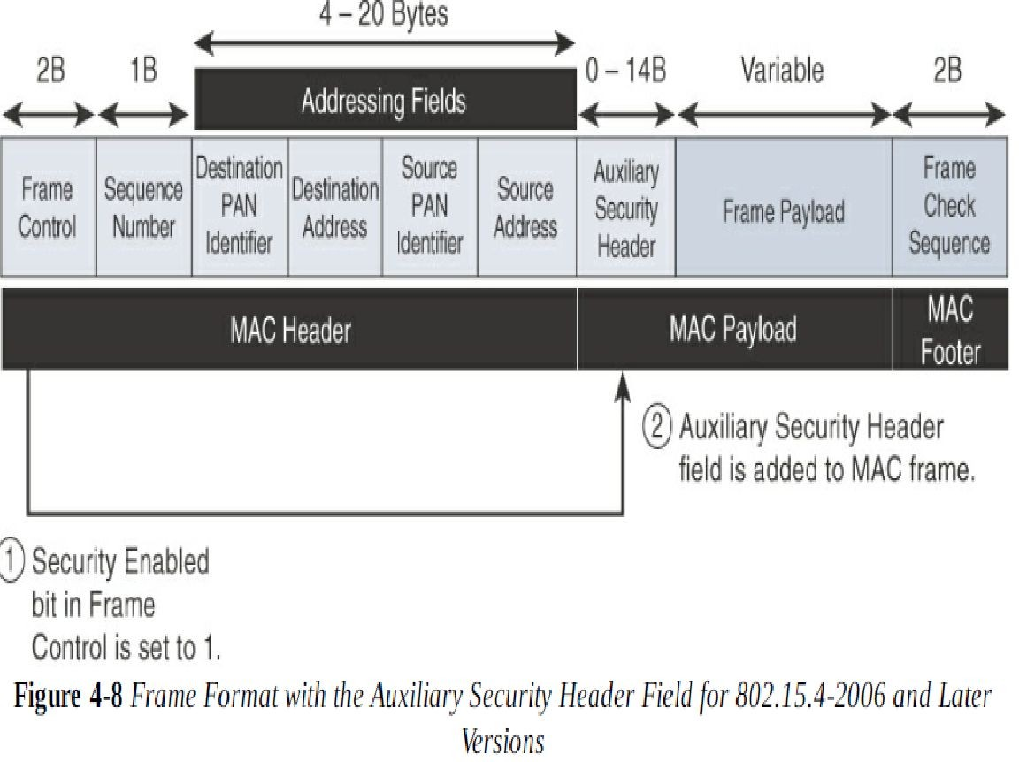

Slide 40
Competitive Technologies
As detailed in Table 4-2, the IEEE 802.15.4 PHY and MAC layers are the foundations for several networking profiles that compete against each other in various IoT access environments
A competitive radio technology that is different in its
PHY and MAC layers is DASH7. DASH7 was
standard and
originally based on the ISO18000-7
positioned for industrial communications
whereas IEEE 802.15.4 is more generic. Commonly employed in active radio frequency identification (RFID) implementations

Slide 41
IEEE 802.15.4g and 802.15.4e
The IEEE 802.15.4e amendment of 802.15.4-2011 expands the MAC layer feature set to remedy the disadvantages associated with 802.15.4, including MAC reliability, unbounded latency, and multipath fading
In addition to making general enhancements to the MAC layer, IEEE 802.15.4e also made improvements to better cope with certain application domains
such as factory and process automation and smart grid. Smart grid is associated with the modernization of the power grid and utilities infrastructure by connecting intelligent devices and communications

Slide 42
IEEE 802.15.4g-2012 is also an amendment to the IEEE 802.15.4-2011 standard, and just like 802.15.4e- 2012
it has been fully integrated into the core IEEE 802.15.4-2015 specification. The focus of this specification is the smart grid or, more specifically, smart utility network communication
802.15.4g seeks to optimize large outdoor wireless mesh networks for field area networks (FANs)
New PHY definitions are introduced, as well as some MAC modifications needed to support their implementation

Slide 43
This technology applies to IoT use cases such as the following
Distribution automation and industrial supervisory control and data acquisition (SCADA)
environments for remote monitoring and control
Public lighting
Environmental wireless sensors in smart cities
Electrical vehicle charging stations
Smart parking meters
Micro grids
Renewable energy

Slide 44
Standardization and Alliances
the additional capabilities and options provided by 802.15.4g-2012 and 802.15.4e-2012 led to additional difficulty in achieving the interoperability between devices and mixed vendors that users requested To guarantee interoperability, the Wi-SUN Alliance was formed. (SUN stands for smart utility network.)
These profiles are based on open standards, such as 802.15.4g-2012, 802.15.4e-2012, IPv6, 6LoWPAN, and
UDP for the FAN profile. The Wi-SUN Alliance performs the same function as the Wi-Fi Alliance and WiMAX Forum.

Slide 45
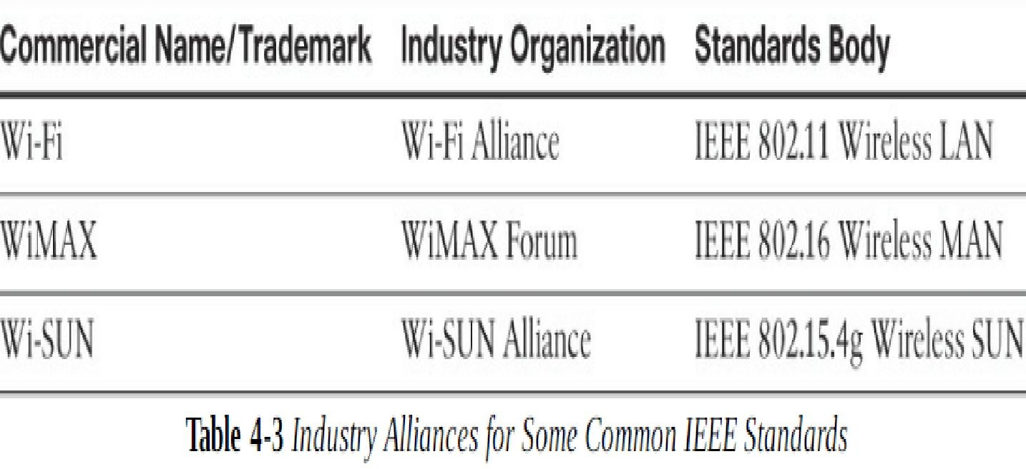
Each of these organizations has an associated standards body as well as a commercial name, as shown in Table 4-3

Slide 46
Physical Layer
In IEEE 802.15.4g-2012, the original IEEE 802.15.4 maximum PSDU or payload size of 127 bytes was increased for the SUN PHY to 2047 bytes. This provides a better match for the greater packet sizes found in many upper-layer protocols
PHY mechanisms to be IEEE 802.15.4g compliant:
Multi-Rate and Multi-Regional Frequency Shift Keying (MR-FSK): Offers good transmit power efficiency due to the constant envelope of the transmit signal
Multi-Rate and Multi-Regional Orthogonal Frequency Division Multiplexing (MROFDM): Provides higher data rates but may be too complex for low-cost and low-power devices
Multi-Rate and Multi-Regional Offset Quadrature Phase-Shift Keying (MR-O-QPSK): Shares the same characteristics of the IEEE 802.15.4-2006 O-QPSK PHY, making multi-mode systems more cost-effective and easier to design

Slide 47
MAC Layer
While the IEEE 802.15.4e-2012 amendment is not applicable to the PHY layer, it is pertinent to the MAC layer.
This amendment
enhances the through various functions,
MAC layer
which may be on various
selectively enabled based
implementations of the standard
In fact, if interoperability is a “must have,” then using profiles defined by organizations such as Wi-SUN is necessary

Slide 48
The following are some of the main enhancements to the MAC layer proposed by IEEE 802.15.4e-2012
Time-Slotted Channel Hopping (TSCH):
Information elements
Enhanced beacons (EBs)
Enhanced beacon requests (EBRs)
Enhanced Acknowledgement
The 802.15.4e-2012 MAC amendment is quite often paired with the 802.15.4g-2012 PHY. Figure 4-9 details this frame format.
Notice that the 802.15.4g-2012 PHY is similar to the
802.15.4 PHY in Figure 4- 5.
The main difference between the two is the payload size, with 802.15.4g supporting up to 2047 bytes and
802.15.4 supporting only 127 bytes

Slide 49
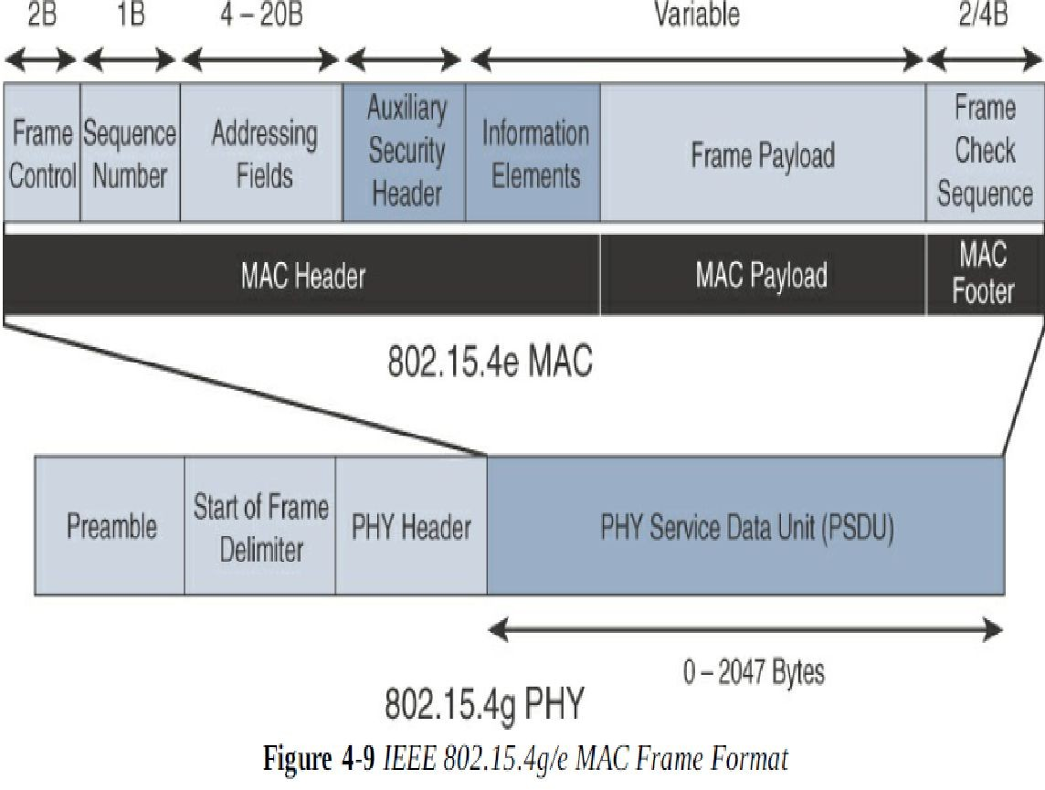

Slide 50
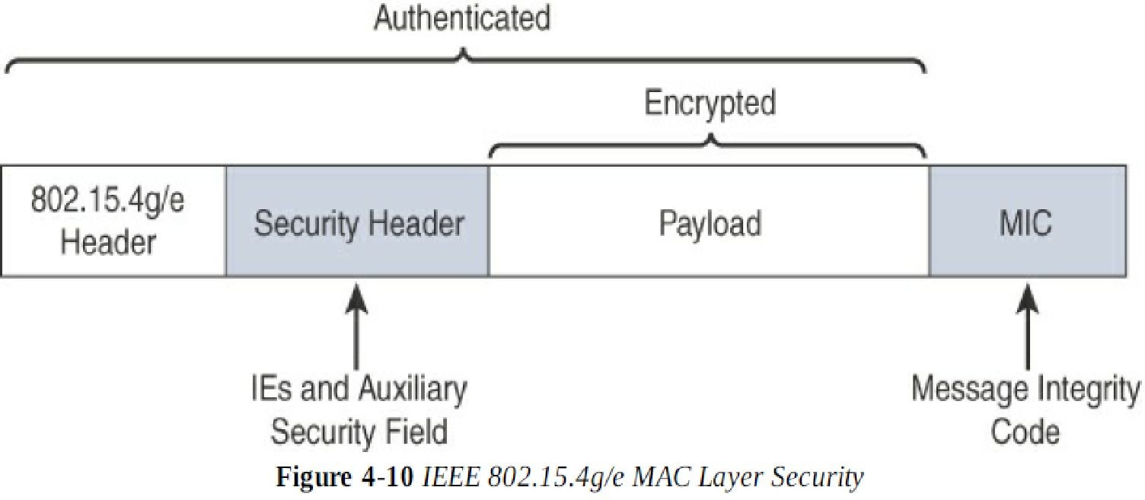
Security
Both IEEE
802.15.4g and 802.15.4e inherit their
security attributes from the IEEE 802.15.4-2006 specification. Therefore, encryption is provided by AES, with a 128-bit key. In addition to the Auxiliary Security Header field initially defined in 802.15.4-2006

Slide 51
Competitive Technologies
Competitive technologies to IEEE 802.15.4g and 802.15.4e parallel the technologies that also compete with IEEE 802.15.4,
such as DASH7. (DASH7 is discussed earlier in this chapter.)
In many ways, 802.15.4 and its various flavours of upper-layer protocols, as shown in Table 4-2, can be seen as competitors as well.
IEEE 802.15.4 is well established and already deployed in many scenarios, mostly indoors

Slide 52
IEEE 1901.2a
While most of the constrained network technologies relate to wireless, IEEE 1901.2a-2013 is a wired technology that is an update to the original IEEE 1901.2 specification.
This is a standard for Narrowband Power Line Communication (NB-PLC).
NB-PLC is often found in use cases such as the following:
Smart metering
Distribution automation
Public lighting
Electric vehicle charging stations
Microgrids
Renewable energy

Slide 53
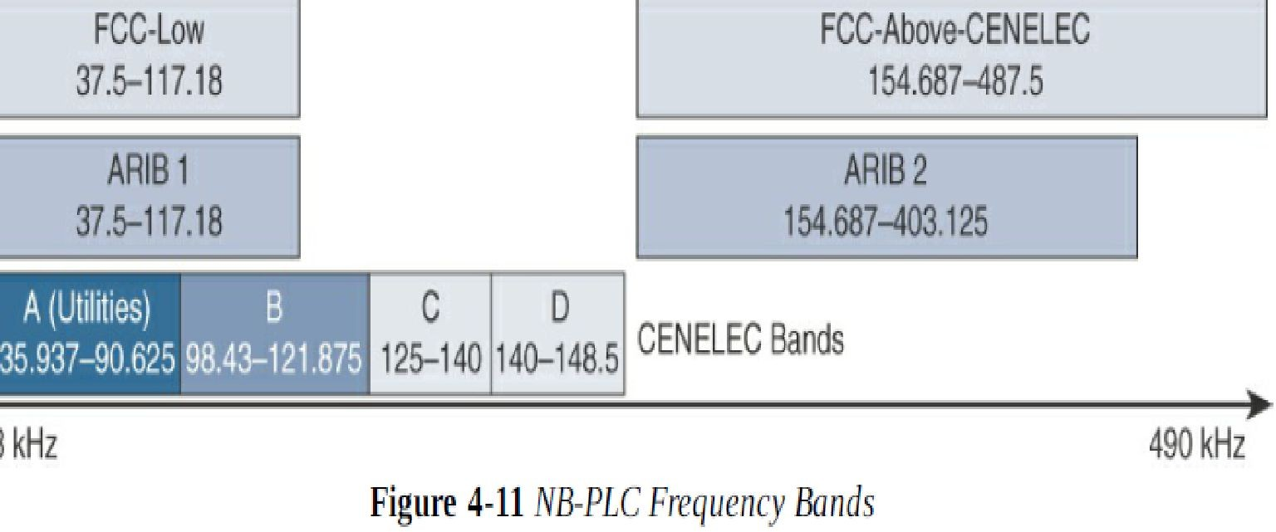
Physical Layer
NB-PLC is defined for frequency bands from 3 to 500 kHz. Much as with wireless sub-GHz frequency bands, regional regulations and definitions apply to NB-PLC.

Slide 54
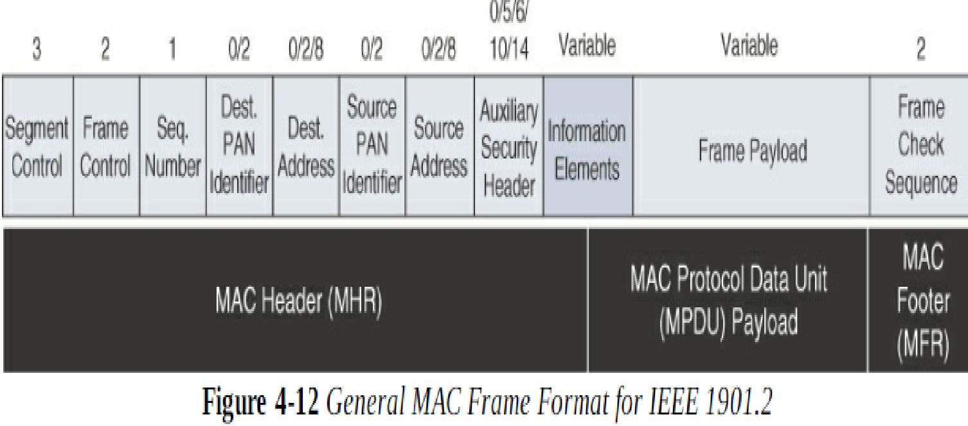
MAC Layer
The MAC frame format of IEEE 1901.2a is based on the IEEE 802.15.4 MAC frame but integrates the latest IEEE 802.15.4e-2012 amendment, which enables key features to be supported

Slide 55
IEEE 802.11ah
In unconstrained networks, IEEE 802.11 Wi-Fi is certainly the most successfully deployed wireless technology
IEEE 802.11 working group launched a task group named IEEE 802.11ah to specify a sub-GHz version of Wi-Fi. Three main use cases are identified for IEEE 802.11ah
Sensors and meters covering a smart grid: Meter to pole, environmental/agricultural, Monitoring, industrial process sensors, indoor healthcare system and fitness sensors, home and building automation sensors
Backhaul aggregation of industrial sensors and meter data: Potentially connecting IEEE 802.15.4g sub networks
Extended range Wi-Fi: For outdoor extended-range hotspot or cellular traffic offloading when distances already covered by IEEE 802.11a/b/g/n/ac are not good enough

Slide 56
Physical Layer
IEEE 802.11ah essentially provides an additional
802.11 physical layer operating in unlicensed sub-GHz bands. Based on OFDM modulation, IEEE 802.11ah uses channels of 2, 4, 8, or 16 MHz
MAC Layer
The IEEE 802.11ah MAC layer is optimized to support the new sub-GHz Wi-Fi PHY while providing low power consumption and the ability to support a larger number of endpoints. Enhancements and features specified by IEEE 802.11ah for the MAC layer

Slide 57
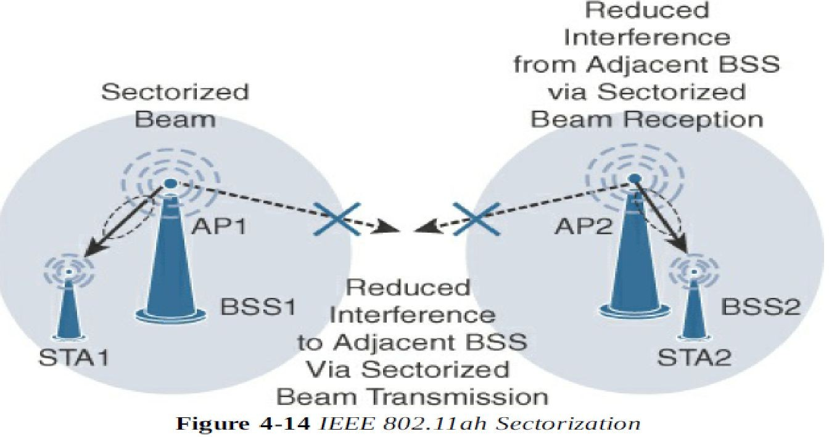
Topology
While IEEE 802.11ah is deployed as a star topology, it includes a simple hops relay operation to extend its range. This relay option is not capped, but the IEEE 802.11ah task group worked on the assumption of two hops

Slide 58
LoRaWAN
In recent years, a new set of wireless technologies known as Low-Power Wide-Area (LPWA) has received a lot of attention from the industry and press.
Particularly well adapted for long-range and battery-powered endpoints, LPWA technologies open new business opportunities to both services providers and enterprises considering IoT solutions.
This section discusses unlicensed-band LPWA LoRaWAN,
an example of an technology, known as

Slide 59
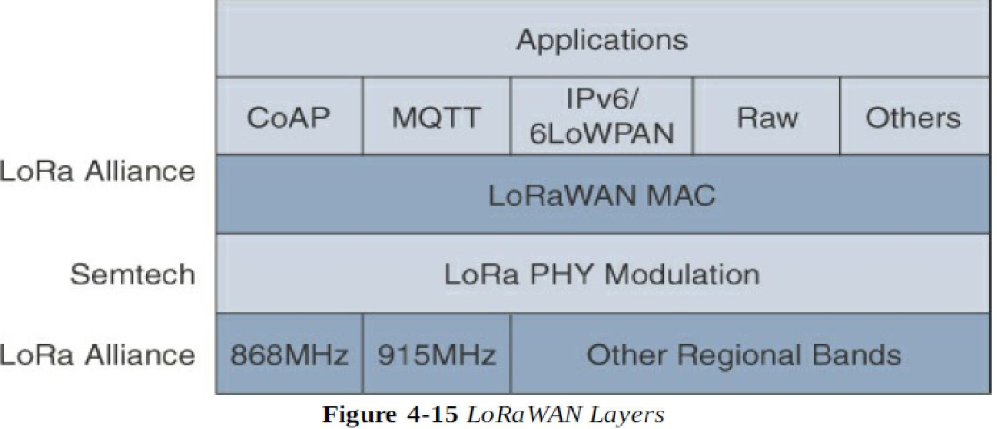
Standardization and Alliances
a high-level overview of the LoRaWAN layers. In this figure, notice that Semtech is responsible for the PHY layer, while the LoRa Alliance handles the MAC layer and regional frequency bands

Slide 60
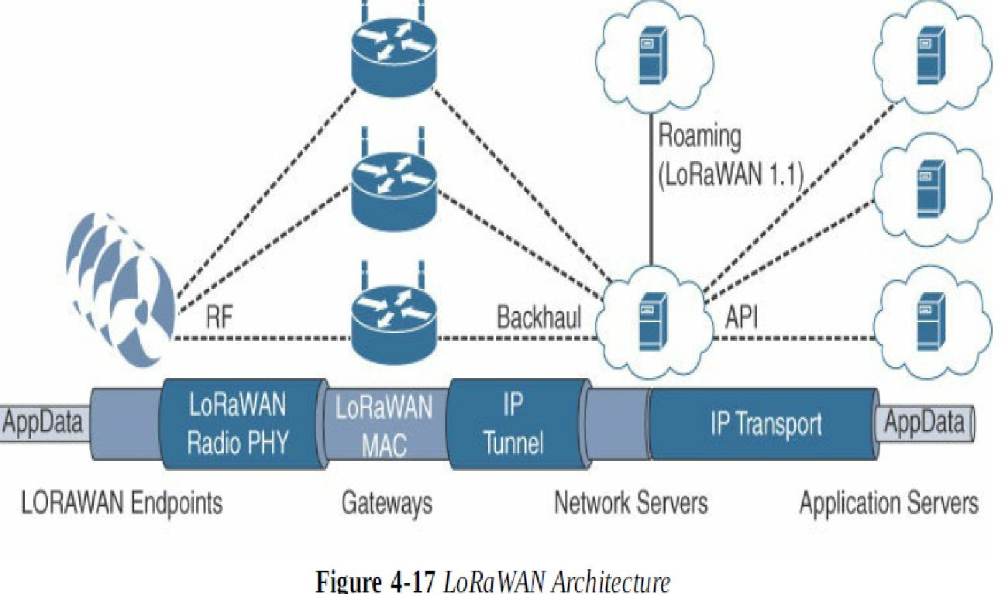
Topology
LoRaWAN topology is often described as a “star of stars” topology

Slide 61
NB-IoT and Other LTE Variations
Existing cellular technologies, such as GPRS, Edge, 3G, and 4G/LTE, are not particularly well adapted to battery-powered devices and small objects specifically developed for the Internet of Things.
industry players have been developing unlicensed-band LPWA technologies, 3GPP and associated vendors have been working on evolving cellular technologies to better address IoT requirements
The effort started with the definition of new LTE device categories. The aim was to both align with specific IoT requirements, such as low throughput and low power consumption, and decrease the complexity and cost of the LTE devices.

Slide 62
NB-IoT
Recognizing that the definition of new LTE device categories was not sufficient to support LPWA IoT requirement, 3GPP specified Narrowband IoT (NB-IoT). The work on NB-IoT started with multiple proposals pushed by the involved vendors, including the following:
Extended Coverage GSM (EC-GSM), Ericsson proposal Narrowband GSM (N-GSM), Nokia proposal
Narrowband M2M (NB-M2M), Huawei/Neul proposal
Narrowband OFDMA (orthogonal frequency-division multiple access), Qualcomm proposal
Narrowband Cellular IoT (NB-CIoT), combined proposal of NB-M2M and NB-OFDMA
Narrowband LTE (NB-LTE), Alcatel-Lucent, Ericsson, and Nokia proposal
Cooperative Ultra Narrowband (C-UNB), Sigfox proposal

